Slide 1
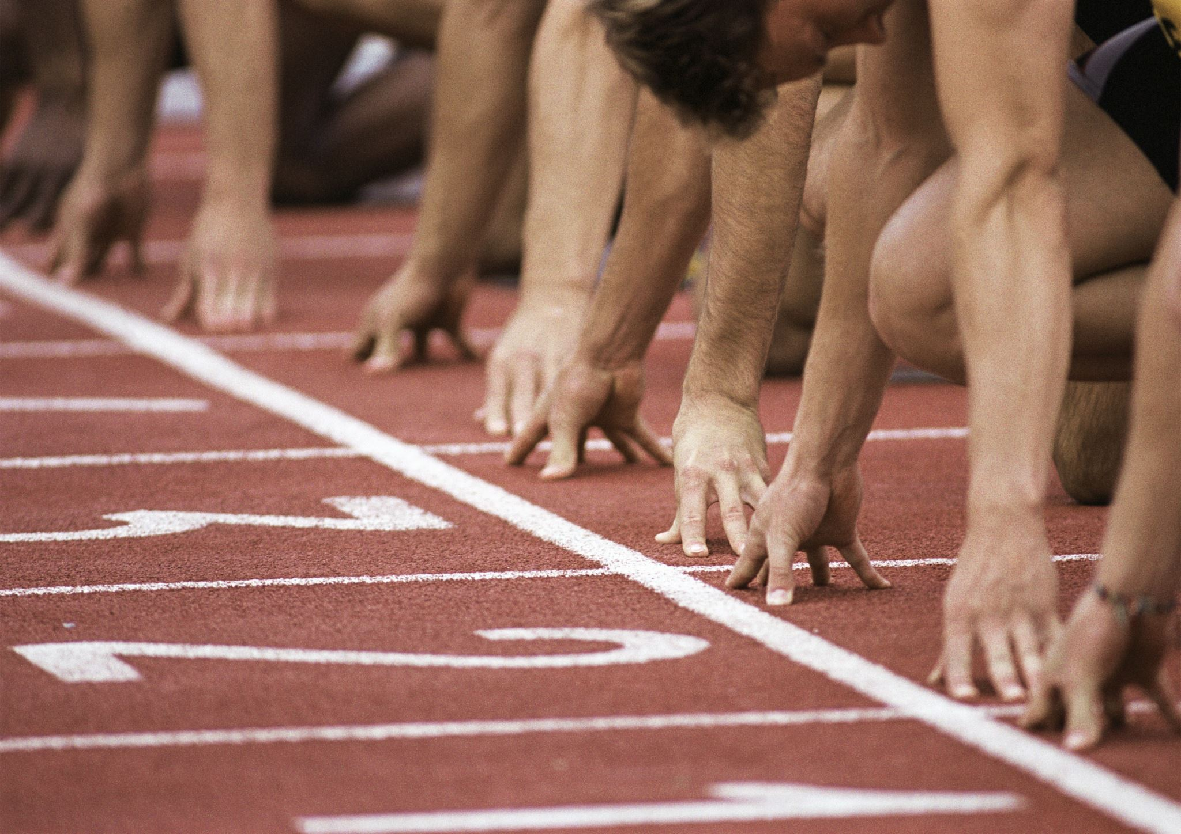
Olympics athlete performance in track & field events
Irene Zou, Jeff Lyng, and David Stagner

Slide 2
Motivation and Summary
We all love the summer Olympics and wanted to learn about how the athletes have progressed over time.
Hypothesis: Athletes have consistently improved over time.
Are athlete’s becoming more physically suited to specific events?

Slide 3
Questions & Data
We will analyze two csv files with summer Olympic medalist data from 1896 to 2016 for three specific track & field events for both male and female.
High Jump
Discus
100 meter
We will analyze the data by the following:
Medalist results by event
Percent change of gold medalists over time
Physical height and weight of the athletes
Data Sources is Kaggle:
Olympic Track & Field Results csv
120 Years of Olympic History: Athletes and Results csv

Slide 4
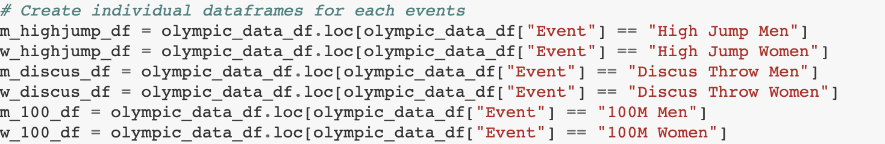
Data Clean-up & Exploration
Manually coded some missing results
Excluded some missing heights and weights
Changed data types from string to float for time results
We created data frames for each event by gender

Slide 5
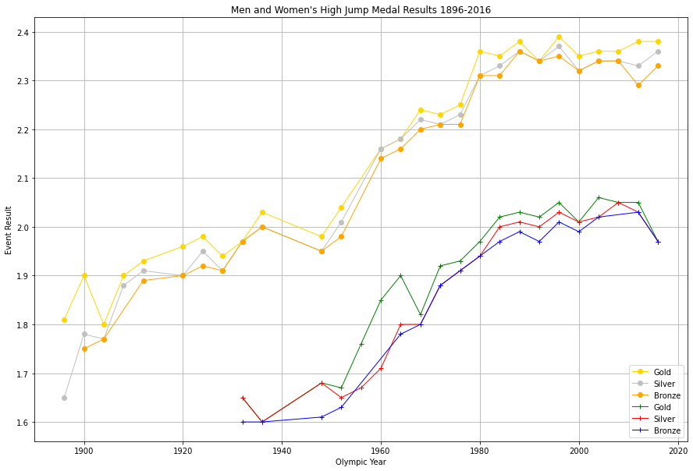
High Jump Results

Slide 6
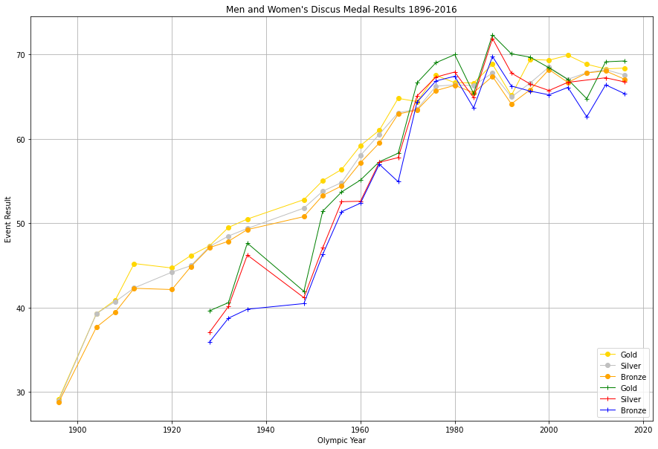
Discus Results

Slide 7
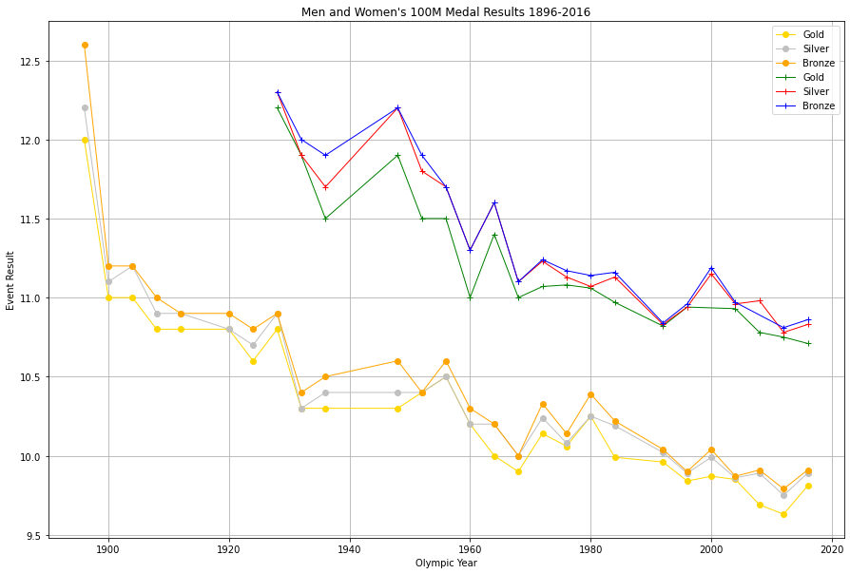
100 Meter Results

Slide 8
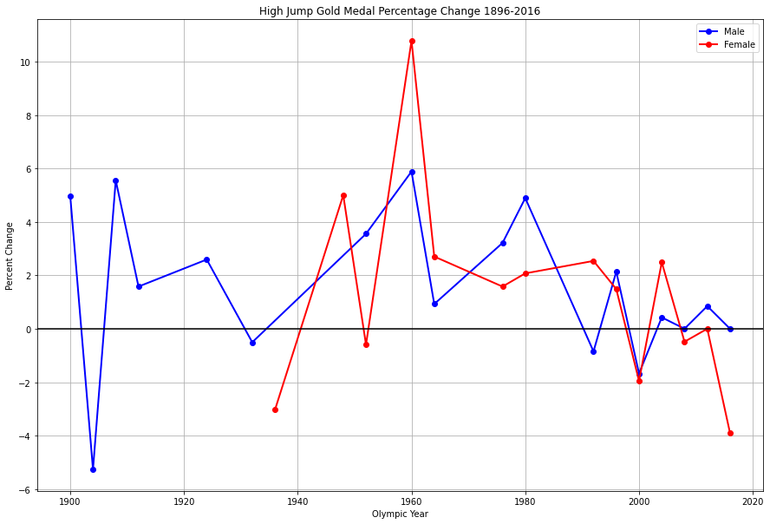
High Jump Percent Change

Slide 9
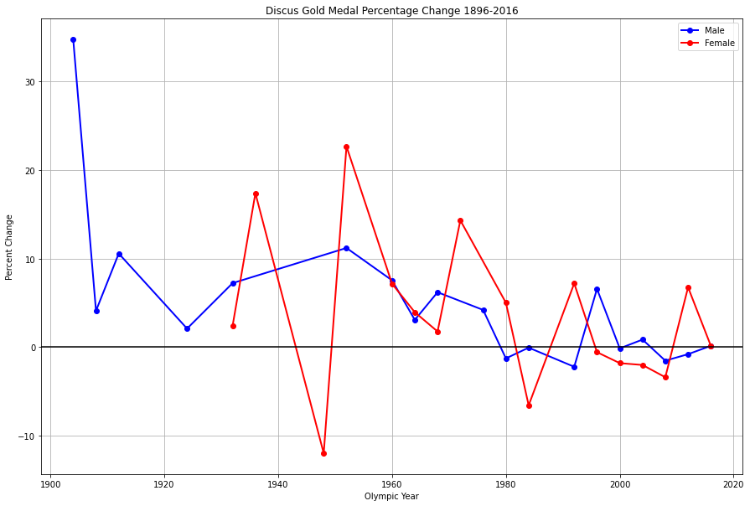
Discus Percent Change

Slide 10
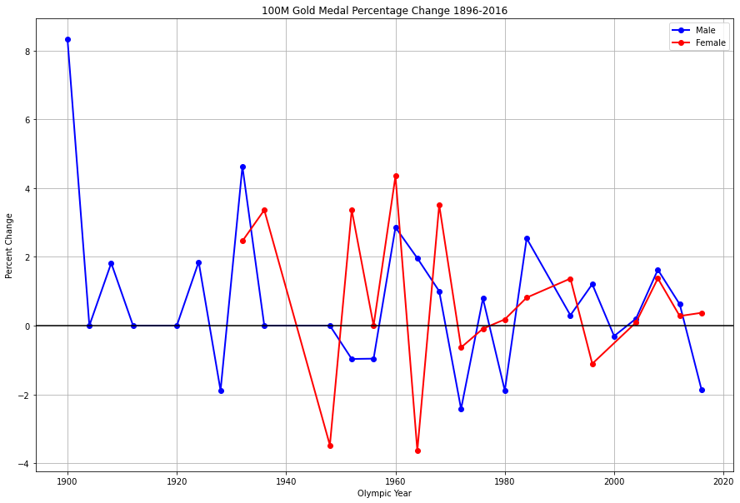
100 Meter Percent Change

Slide 11
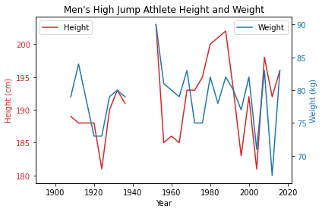
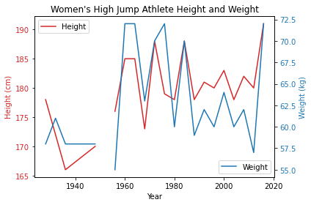
High Jump Physical Attributes By Gender

Slide 12
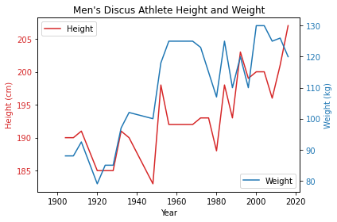
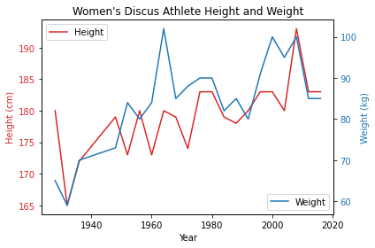
Discus Physical Attributes By Gender

Slide 13
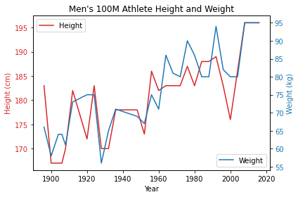
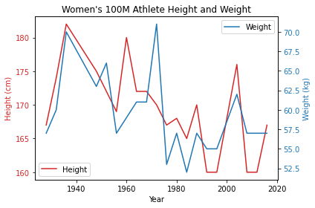
100M Physical Attributes By Gender

Slide 14
Discussion
Athlete’s performance improved greatly from 1896 to mid-1980 and has leveled off from that time to 2016.
The percent change has been mostly positive year over year
The physical attributes of athletes do appear to change over time depending on the event and gender.

Slide 15
Post-Mortem
Topics for Further Analysis:
Would have liked to take a deeper dive into percent change.
For example analyzing the 1896 to 1980s period as well as the 1980s to present
Would have liked to analyze performance by country
Would have liked to included data on training, equipment, and technological advances
Would have liked to analyze more than three events

Slide 16
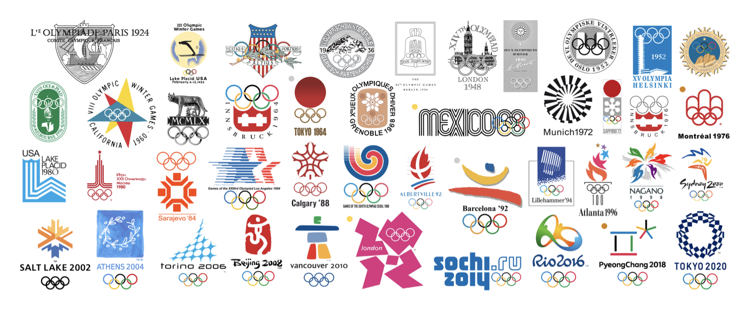

Questions

